Slide 1
Pandas (Python Module) Seyyed Ali Shohadaalhosseini

Slide 2
Introduction
What is Pandas?
Pandas is a Python library used for working with data sets.
It has functions for analyzing, cleaning, exploring, and manipulating data.
The name "Pandas" has a reference to both "Panel Data", and "Python Data Analysis" and was created by Wes McKinney in 2008.

Slide 3
Why Use Pandas?
Pandas allows us to analyze big data and make conclusions based on statistical theories.
Pandas can clean messy data sets, and make them readable and relevant.
Relevant data is very important in data science.
Data Science: is a branch of computer science where we study how to store, use and analyze data for deriving information from it.

Slide 4
What Can Pandas Do?
Pandas gives you answers about the data. Like:
Is there a correlation between two or more columns?
What is average value?
Max value?
Min value?
Pandas are also able to delete rows that are not relevant, or contains wrong values, like empty or NULL values. This is called cleaning the data.

Slide 5
Where is the Pandas Codebase?
The source code for Pandas is located at this GitHub repository https://github.com/pandas-dev/pandas

Slide 6
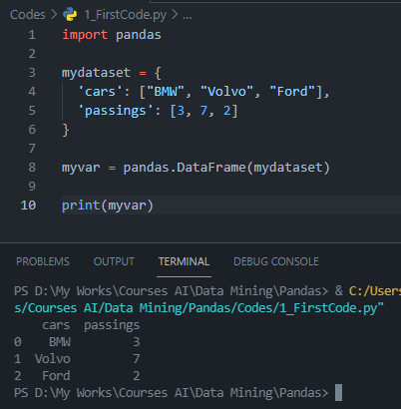
Let’s get into coding
Look at the front example
alias: In Python alias are an alternate name for referring to the same thing.

Slide 8
Overview
Give a brief overview of what you’ll cover in your presentation.

Slide 9
History
Make a timeline of the important historical events or list historical contributions made by people of African heritage.
1st Event | 2nd Event | 3rd Event | 4th Event | 5th Event | 6th Event
Date | Date | Date | Date | Date | Date
Description | Description | Description | Description | Description | Description

Slide 10
Interesting facts
List some interesting facts about Black History Month. Here are a few examples:
In 1926, Carter G. Woodson launched a weeklong celebration of black history in the United States.
In 1976, President Gerald Ford officially recognizes Black History Month.
Black History Month is also celebrated by Canada, Ireland, The Netherlands, and the United Kingdom.

Slide 11
Key people
Choose three leaders for Black History Month using Bing.com and discuss their lives and accomplishments. Here are some examples:
Bayard Rustin was a close advisor to Martin Luther King and an American leader of the civil rights movement. Rustin organized and led several protests, including the 1963 March on Washington.
Jesse Owens was an American track and field athlete and four-time gold medalist in the 1936 Olympic Games in Germany. Owens specialized in the sprints and the long jump.
Zora Neale Hurston was an American author, anthropologist, and filmmaker. In 1937, she published her famous novel, Their Eyes Were Watching God.

Slide 12
Arts and literature
Provide examples of art and literature that are significant to Black History Month. Here are a few examples:
The writing of James Baldwin
The music of Miles Davis
The artwork of Alma Thomas

Slide 13
How to celebrate
List some ways you can celebrate Black History Month. Here are a few examples:
Discover African American artists
Read African American authors
Listen to African American musicians
Learn important moments of African American history

Slide 14
Conclusion
Provide a brief summary of your presentation. Remind the audience what you covered in the previous slides.

Slide 15
Questions & answers
Invite questions from the audience

Slide 16
Resources
List the resources you used for your research:
Source #1
Source #2
Source #3

